Slide 1

Optimal Coffee Shop Location - Toronto
Calvin Todorovich

Slide 2

90%
Amount of Americans that drink caffeine daily
Making cafes one of the most dependable businesses opportunities

Slide 3

How to find a Good Cafe Location
According to Rick Suttle [3] the best way to predict profit is to know your customer base. This is not so difficult for cafes, since the majority of people drink coffee.
The best variables to predict profit (for any business) are:
Income
Age
Location (Proximity to customers)

Slide 4
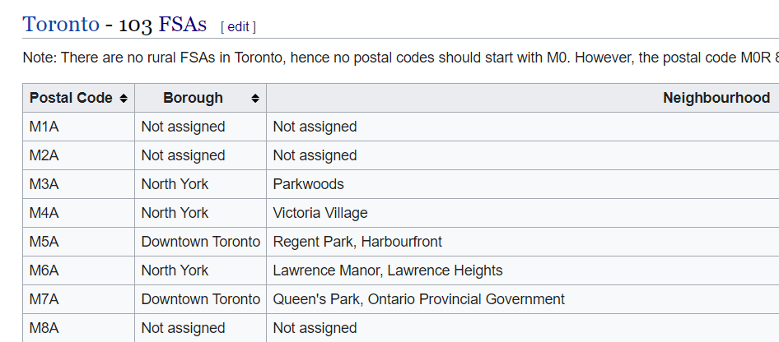
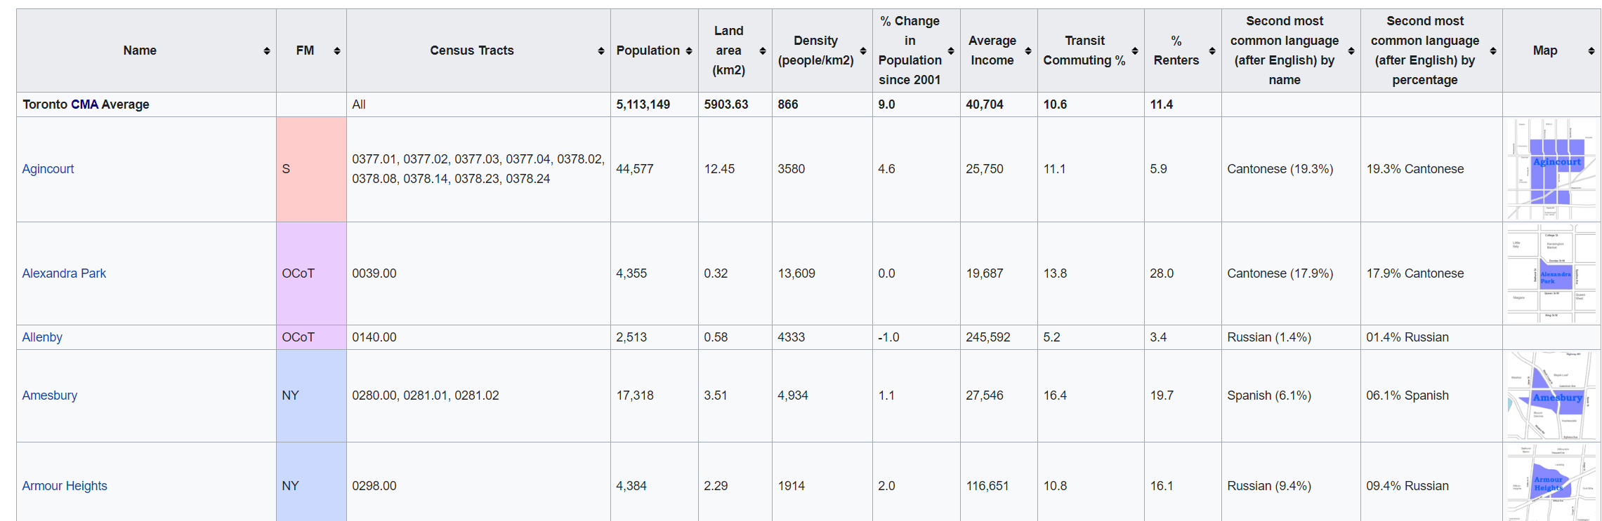
Data Acquisition and Cleaning
Location Data:
Demographics:
Steps for cleaning:
Replace NaN values with Borough
If borough is unassigned too, drop row
Steps for cleaning:
Match the Neighborhoods (Name) between data sets
Will standardize the variables

Slide 5
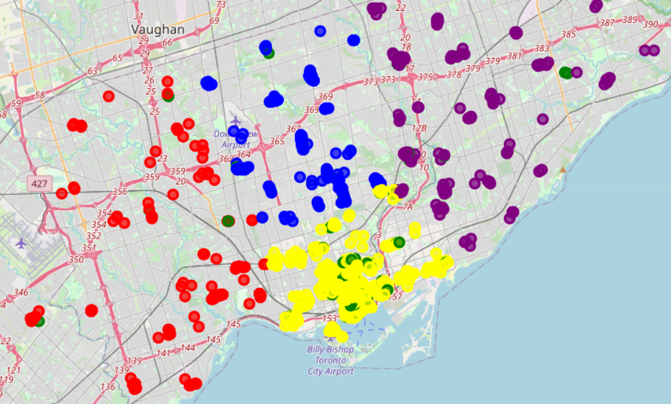
Clustering & Competition
Observations:
Most Cafes are located Downtown
Surprisingly few coffee shops near University
Areas with low density of coffee shops could lead to increase in business, due to low competition.
*Label map with Neighborhood names

Slide 6
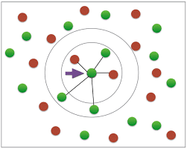
Coffee Distance
I wanted to generate data that represents amount of competition
Using foursquare venue data and SKLearn’s nearest neighbors, I made an algorithm that adds the distance to the nearest venue of a specified type for each location.
For this project, I simply put in “Coffee Shop” and my dataset has a column appended representing the distance to the nearest cafe

Slide 7
Demographics
Based on [Source] the best demographics variables for profit are:
Population ⇒ a raw amount of potential customers
Average Income ⇒ More income means more disposable income for premium coffee
Density ⇒ A more dense population will lead to higher proximity to customers in the area (e.g. coffee shop on bottom level of apartment complex)
Commuting % ⇒ Measures how many customers you could be getting outside of the population of Neighborhood on daily basis.

Slide 8
Profit Score
ProfitScore = ⅕(Population + Income + Density + Commuting% + CoffeeDistance)
With data from companies for profit, I will be able to develop the model beyond using the average of these variables
Group each Neighborhood to average all venues in the area
Each Neighborhood now has a score; a result that is easier to communicate

Slide 9
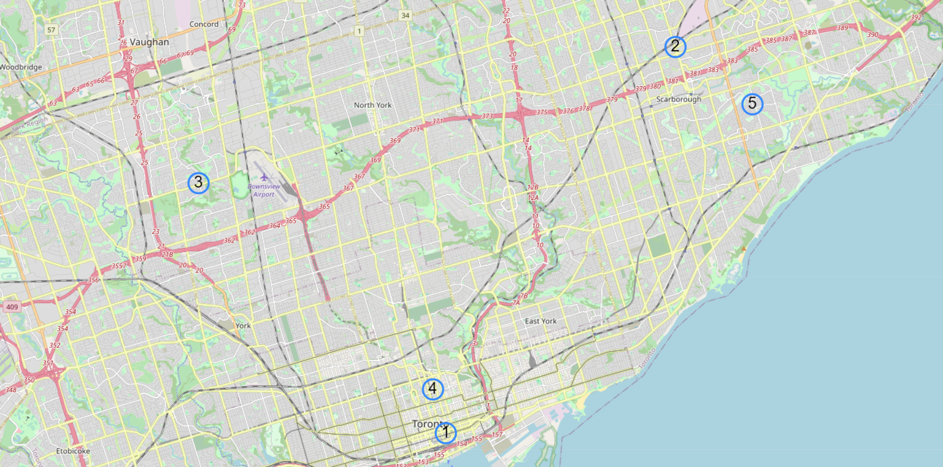
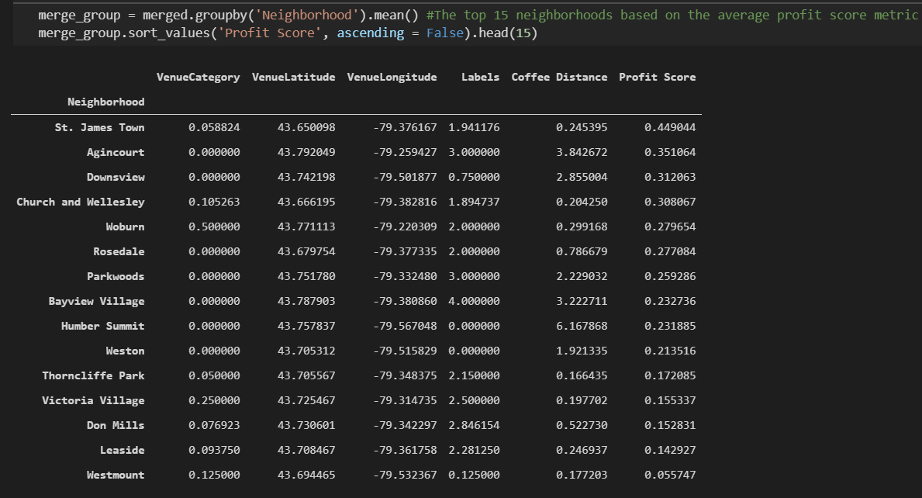
Results
Agincourt
There was a good mix of areas that are dense with population
(St. James Town, Church and Wellesley)
And areas that have lack of competition
(Agincourt, Downsview)
Woburn
Downsview
Church and Wellesley
St. James Town
St James Town is located in the heart of downtown, making it have high business opportunity, but lots of competition
Agincourt had the highest coffee distance of all neighborhoods, making it the most isolated
Downsview is situated right next to an airport, and also has high coffee distance
Church and Wellesley has close proximity to the University, making it a good business opportunity as well

Slide 10
Conclusion
For Toronto, I recommend opening a coffee shop in:
St. James Town for the population and commuting.
Church and Wellesley for the proximity to the University
Agincourt, if you want the most isolated location (least competition).

Slide 11
Future Directions
With more data, such as profit margins, I plan to use machine learning algorithms to develop the model
Decision Tree to determine best predictors for profit.
Recommender systems based on where other profitable coffee shops exist
Model Evaluation
Other variables I will consider in the future are:
Proximity to office buildings (or other businesses) for more customers
Amount of parking
Age, to target most coffee drinkers

Slide 12
Citation
“Caffeine: America's Most Popular Drug.” Kukani, www.kuakini.org/wps/portal/public/Health-Wellness/Health-Info-Tips/Miscellaneous/Caffeine--America-s-Most-Popular-Drug#:~:text=Every%20day%2C%20about%2090%20percent,it%20America's%20most%20popular%20drug.
City of Toronto. “Toronto at a Glance.” City of Toronto, 29 July 2020, www.toronto.ca/city-government/data-research-maps/toronto-at-a-glance/.
Suttle, Rick. “The Demographic Variables That Affect a Business.” Small Business - Chron.com, Chron.com, 20 Mar. 2019, smallbusiness.chron.com/demographic-variables-affect-business-24344.html.
“Demographics of Toronto Neighbourhoods.” Wikipedia, Wikimedia Foundation, 25 July 2020, en.wikipedia.org/wiki/Demographics_of_Toronto_neighbourhoods.
“List of Postal Codes of Canada: M.” Wikipedia, Wikimedia Foundation, 25 July 2020, en.wikipedia.org/wiki/List_of_postal_codes_of_Canada:_M.
4.
5.
Thanks for watching!

